Slide 1
物理光学
Physical Optics
第1讲、复数与物理量的数学表示
Lecture 1. Complex Numbers Review and Mathematical
Representation of Physical Quantities

Slide 2
1、INTRODUCTION
为什么要用复数？
物理定义受限
Notes:
1、The enabling concept for complex numbers is to deﬁne the imaginary number as
2、and then to deﬁne an arbitrary complex number in terms of its real and imaginary parts as
where v and w are both real numbers. We will be using the notation j for the imaginary number, which is conventional in most engineering applications.
3、 Figure 1 shows the function √x. Other functions like ln x, sin x, etc., also have limits on their arguments, and complex numbers allow us to deﬁne these functions over the full range of real numbers.

Slide 3
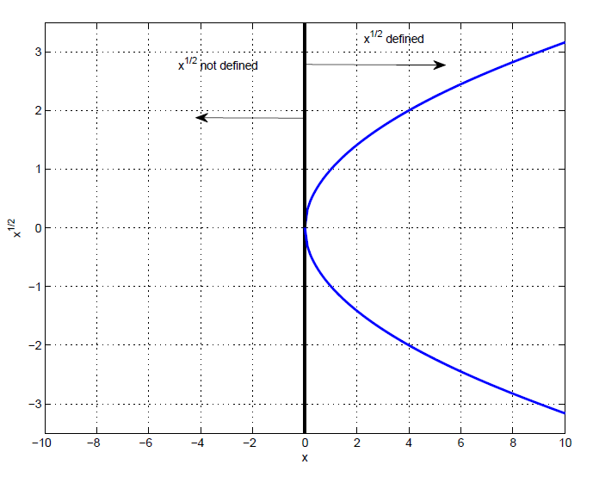
1、INTRODUCTION
假如不定义复数：限制了定义域
Notes:
1、The enabling concept for complex numbers is to deﬁne the imaginary number as
2、and then to deﬁne an arbitrary complex number in terms of its real and imaginary parts as
where v and w are both real numbers. We will be using the notation j for the imaginary number, which is conventional in most engineering applications.
3、 Figure 1 shows the function √x. Other functions like ln x, sin x, etc., also have limits on their arguments, and complex numbers allow us to deﬁne these functions over the full range of real numbers.

Slide 4
1、INTRODUCTION
为什么要用复数？
物理光学中大量物理量需要用三角函数来描述
复数通过引入虚部简化了定义和数学表达式
比只用实数表示更方便，更容易计算
简单回顾复数的定义和计算方法
Notes:
1、The enabling concept for complex numbers is to deﬁne the imaginary number as
2、and then to deﬁne an arbitrary complex number in terms of its real and imaginary parts as
where v and w are both real numbers. We will be using the notation j for the imaginary number, which is conventional in most engineering applications.
3、 Figure 1 shows the function √x. Other functions like ln x, sin x, etc., also have limits on their arguments, and complex numbers allow us to deﬁne these functions over the full range of real numbers.

Slide 5
1、INTRODUCTION
复数的基础：
定义虚数
含义相同
实部 虚部
v和w都是实数
Notes:
1、The enabling concept for complex numbers is to deﬁne the imaginary number as
2、and then to deﬁne an arbitrary complex number in terms of its real and imaginary parts as
where v and w are both real numbers. We will be using the notation j for the imaginary number, which is conventional in most engineering applications.
3、 Figure 1 shows the function √x. Other functions like ln x, sin x, etc., also have limits on their arguments, and complex numbers allow us to deﬁne these functions over the full range of real numbers.

Slide 6
1、INTRODUCTION
定义复数之后：描述更多物理意义
Notes:
1、The enabling concept for complex numbers is to deﬁne the imaginary number as
2、and then to deﬁne an arbitrary complex number in terms of its real and imaginary parts as
where v and w are both real numbers. We will be using the notation j for the imaginary number, which is conventional in most engineering applications.
3、 Figure 1 shows the function √x. Other functions like ln x, sin x, etc., also have limits on their arguments, and complex numbers allow us to deﬁne these functions over the full range of real numbers.

Slide 7
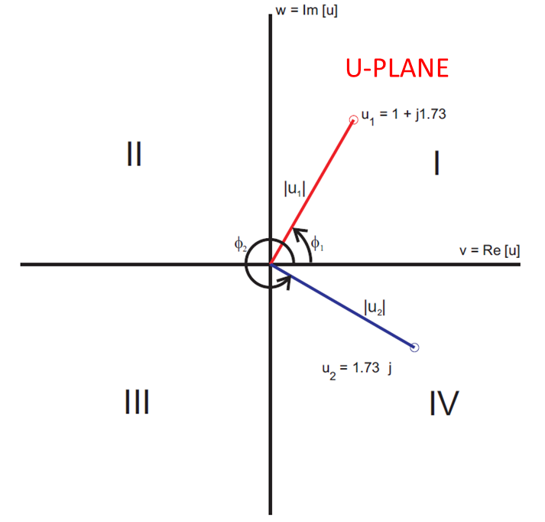
1、INTRODUCTION
复数的直角坐标表述：
Notes:
1、You should be comfortable using both. We will often have recourse to extract the real and/or imaginary parts of a given complex number, and these are denoted as
2、In deﬁning the imaginary number, it should not come as a surprise from Eq. 2 that you cannot add together a real number and an imaginary number to get zero. Because of this, we can treat the real part and imaginary part of u as orthogonal and plot them in a two-dimensional plane as shown in Fig. 2. By exploiting this analogy, we can also deﬁne a complex number in terms of its magnitude and angle (also referred to as magnitude and argument)

Slide 8
1、INTRODUCTION
复数的极坐标表述：
Notes:
1、By exploiting this analogy, we can also deﬁne a complex number in terms of its magnitude and angle (also referred to as magnitude and argument)
2、We can exploit Euler’s identidy to write the complex number in its polar form
3、Let’s now consider some two examples, such as

Slide 9
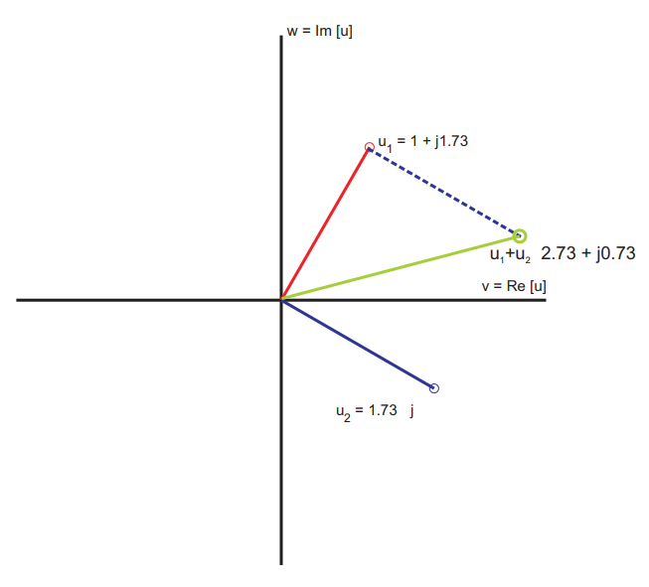
2、COMPLEX ALGEBRA
复数的运算：加减(直角坐标更方便)
Notes:
1、Consider two arbitrary complex numbers
2、We add these two numbers vectorally as indicated in Fig. 4 by adding the real and imaginary parts independently. The ﬁnal result is

Slide 10
2、COMPLEX ALGEBRA
复数的运算：乘除(极坐标更方便)
复数运算的性质:
Notes:
1、Multiplication can be computed using either the rectangular form (real/imaginary) or polar form of the complex numbers by following the normal rules of multiplication. We have
2、We used the deﬁnition of the imaginary number j2 = −1 to simplify Eq. 18. Division is accomplished most easily in polar coordinates
We can also evaluate division in rectangular coordinates as

Slide 11
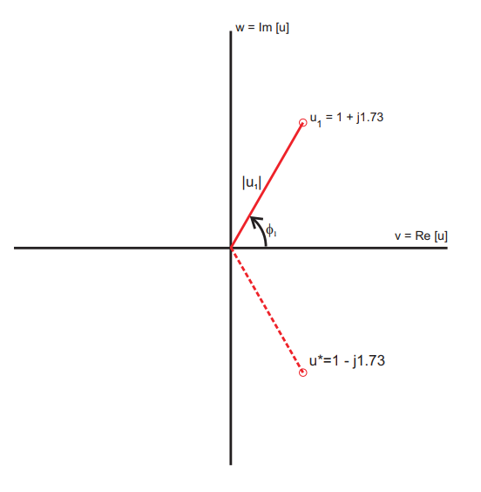
2、COMPLEX ALGEBRA
一对特殊的复数：复共轭
Notes:
1、Some handy properties of complex arithmetic are

Slide 12
2、COMPLEX ALGEBRA
复共轭的性质:
复数除法的快速运算:
Notes:
1、Some handy properties of complex arithmetic are

Slide 13
2、COMPLEX ALGEBRA
复数的运算：n次方与n次方根(极坐标更方便)
复数的运算： n次方与n次方根的多值性
Notes:
1、Powers and roots of a complex number are most easily analyzed in polar coordinats using the standard rules for these operations. For powers we have the relationship
2、Taking the root of a complex number is a bit trickier. We must say that

Slide 14
2、COMPLEX ALGEBRA
复数的意义
实数简谐波:
freq
简谐波的复数表示:
Notes:
1、Consider a sinusoidally varying signal given by
2、The quantity u˜(ξ0) is the complex phasor of the signal v(x), and note that it is a function of frequency ξ0. This representation is variously known as the time-harmonic representation or the frequency domain representation.
Why would we go through the trouble of doing this? Well, let’s consider the superposition of two sinusoids at the same frequency ξ0, but with diﬀerent phases. Without loss of generality we take the phase of the ﬁrst signal to be 0. We have

Slide 15
2、COMPLEX ALGEBRA
两个简谐波的叠加: 实数运算

Slide 16
2、COMPLEX ALGEBRA
Notes:
1、Using the trigonometric identity cos(A + B) = cos A cos B − sin A sin B we have
2、We can proceed one step further by noting that |B1|≤ 1, |B2|≤ 1, and B12 + B22 = 1. These are the properties of the sine and cosine of an arbitrary angle. If we then deﬁne
3、then we have B1 = cos Φ and B2 = sin Φ, which yields
4、That certainly seemed tedious to me. Let’s try this another way. Define the phasors
5、If we form
6、then we can concisely and immediately write
7、where A = ／[(A1 + A2 cos φ)2 + (A2 sin φ)2 and Φ = tan−1[−A2 sin φ/(A1 + A2 cos φ)] using our knowledge of
complex numbers. The latter method was much more straightforward

Slide 17
2、COMPLEX ALGEBRA
两个简谐波的叠加: 复数运算
Notes:
1、Using the trigonometric identity cos(A + B) = cos A cos B − sin A sin B we have
2、We can proceed one step further by noting that |B1|≤ 1, |B2|≤ 1, and B12 + B22 = 1. These are the properties of the sine and cosine of an arbitrary angle. If we then deﬁne
3、then we have B1 = cos Φ and B2 = sin Φ, which yields
4、That certainly seemed tedious to me. Let’s try this another way. Define the phasors
5、If we form
6、then we can concisely and immediately write
7、where A = ／[(A1 + A2 cos φ)2 + (A2 sin φ)2 and Φ = tan−1[−A2 sin φ/(A1 + A2 cos φ)] using our knowledge of
complex numbers. The latter method was much more straightforward

Slide 18
谢谢！

