Slide 1
物理光学
Physical Optics
第2讲、一些特殊的函数以及冲激函数
Lecture 2. Special Functions and The Impulse Function

Slide 2
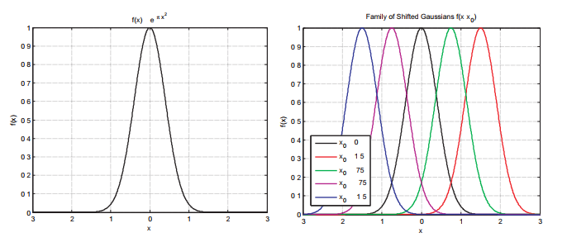
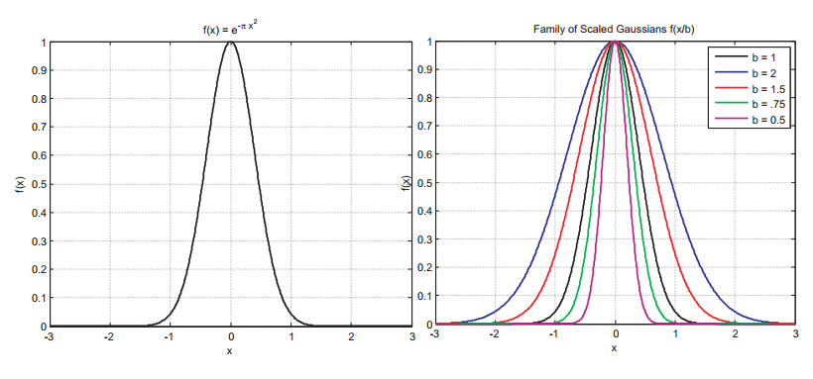
1. SPECIAL FUNCTIONS
函数的平移与缩放：
线性系统中的平移和缩放
MATLAB仿真
Notes:
1、We will be working not just with functions, but with scaled and shifted versions of functions. Our general notation for a scaled and shifted function will look like
2、where the parameter x0 represents the shift, and the parameter b provides the scale. Figure 1 shows an example for a Gaussian function. We will look at the Gaussian function in a bit more detail later on in this lecture, but for now let’s take the expression

Slide 3
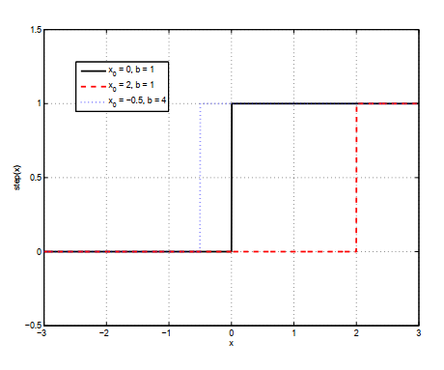
1. SPECIAL FUNCTIONS
符号函数:
线性系统中的反相器
MATLAB仿真
Notes:
1、It should be noted that we have deﬁned step(0) = 1 . This is commonly used, but not necessary. Many authors deﬁne step(0) = 0 or step(0) = 1. The speciﬁc choice is unimportant, as no physically realizable function can actually be discontinuous like this, and the step function is only an idealization that is convenient for analysis. However, by deﬁning the function this way, we may write
2、where sgn(x) is the sign or signum function

Slide 4
1. SPECIAL FUNCTIONS
单位阶跃函数：
MATLAB仿真
Notes:
1、The step function is one that is used (usually) to turn other functions on or off. For example, we can write the illumination that passes a knife edge in a diffraction experiment as the product of the incident electromagnetic field with a step function that defines the edge. We can define the step function as

Slide 5
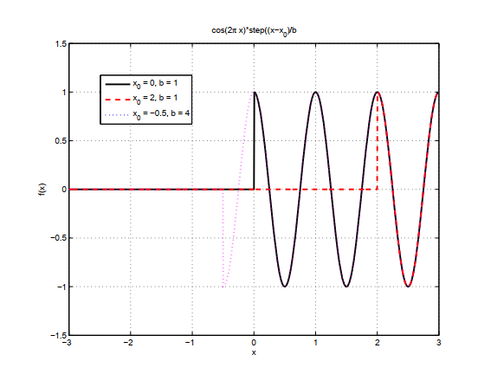
1. SPECIAL FUNCTIONS
单位阶跃函数：
线性系统中的光阑刀口
MATLAB仿真
Notes:
1、It should be noted that we have deﬁned step(0) = 1 . This is commonly used, but not necessary. Many authors deﬁne step(0) = 0 or step(0) = 1. The speciﬁc choice is unimportant, as no physically realizable function can actually be discontinuous like this, and the step function is only an idealization that is convenient for analysis. However, by deﬁning the function this way, we may write
2、where sgn(x) is the sign or signum function

Slide 6
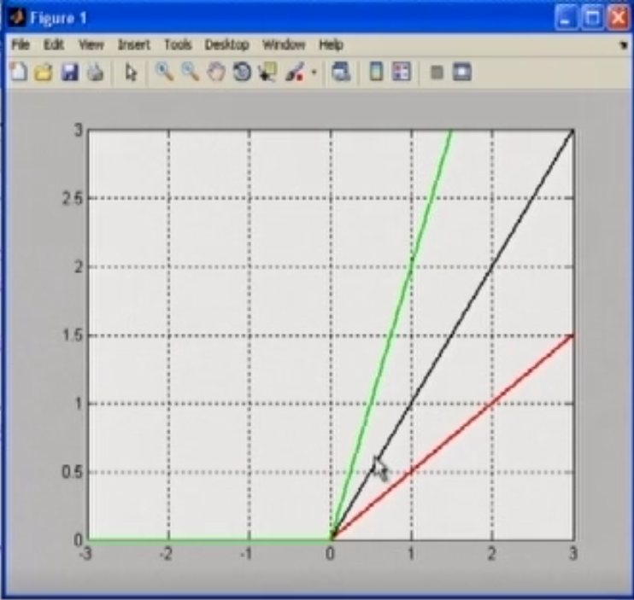

1. SPECIAL FUNCTIONS
斜坡函数:
对中间变量$α$的定积分
MATLAB仿真
Notes:
1、We can deﬁne the ramp function as the integral of the step function as
2、Several ramp functions are plotted with diﬀerent values of scale and shift in Fig. 6. We note that the slope of the line in the ramp ((x − x0)/b) is equal to 1/b.

Slide 7
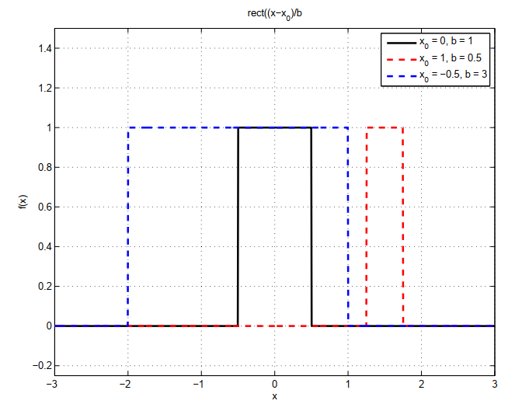
1. SPECIAL FUNCTIONS
矩形脉冲函数:
线性系统中的光阑滤波
MATLAB仿真
Notes:
1、The rectangular pulse function is used to approximate a number of physical processes encountered in optics such as slits and rectangular apertures. We can deﬁne the rectangular pulse in terms of the unit step function as
2、Several scaled and shifted versions of the pulse function are shown in Fig
3、Let’s consider the area under the rectangular pulse function. Define

Slide 8
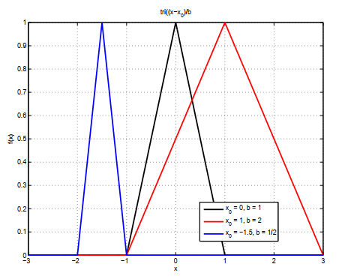
1. SPECIAL FUNCTIONS
三角形函数:
MATLAB仿真
Notes:
1、The triangle function creates a pulse that, unlike the rect function, is continuous for all values of the argument.We define the triangle function as
2、Figure shows several scaled and shifted version of the triangle function. The integrated area of the trianglefunction with this normalization is

Slide 9
1. SPECIAL FUNCTIONS
高斯函数:自身的傅里叶变换对
概率论中的生态分布
MATLAB仿真
Notes:
1、The Gaussian function is deﬁned in the notation of Gaskill as
2、As with the sinc function, we use this particular deﬁnition with the factor of π in the argument because of the normalization properties that we will see below. We have already looked as the scaling and shifting properties of the Gaussian in Fig. 1 and Fig. 2. However, we note that the Gaussian has area
3、As with the integral of the sinc function, this integral is tabulated as well. However, it is possible to evaluate this integral using a simple change of variables and an algebraic trick (it’s on Wikipedia, give it a try).

Slide 10
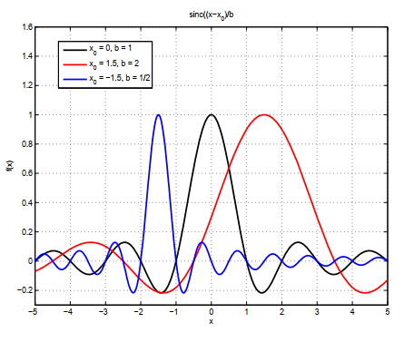
1. SPECIAL FUNCTIONS
Sinc函数:矩形脉冲函数的傅里叶变换对
MATLAB仿真
Notes:
1、The sinc function is closely related to the rect function through the Fourier transform, and this will be very important in both signal processing and in diﬀraction later on in the term. We can deﬁne the sinc function using Gaskill’s notation as
2、The sinc function has some important properties that are worth committing to memory. The zeros of the sinc function can be located as
3、The sinc function has a problem when x → 0. At this point, we have sinc (0) = 0/0, and we need to use to another method to evaluate the function at this point. We appeal to the Taylor series expansion of sin(x) to do this and we have

Slide 11
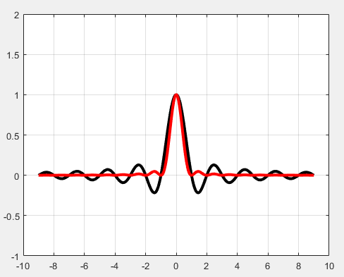
1. SPECIAL FUNCTIONS
Sinc²函数:三角形函数的傅里叶变换对
MATLAB仿真
Notes:
1、The sinc function is closely related to the rect function through the Fourier transform, and this will be very important in both signal processing and in diﬀraction later on in the term. We can deﬁne the sinc function using Gaskill’s notation as
2、The sinc function has some important properties that are worth committing to memory. The zeros of the sinc function can be located as
3、The sinc function has a problem when x → 0. At this point, we have sinc (0) = 0/0, and we need to use to another method to evaluate the function at this point. We appeal to the Taylor series expansion of sin(x) to do this and we have

Slide 12
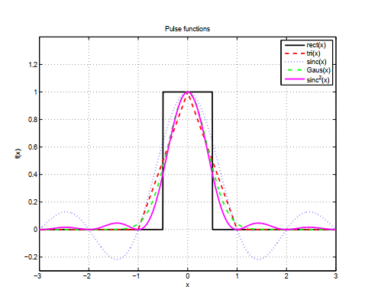
1. SPECIAL FUNCTIONS
假如脉冲函数宽度无限缩小
MATLAB仿真
Notes:
1、The Gaussian function is deﬁned in the notation of Gaskill as
2、As with the sinc function, we use this particular deﬁnition with the factor of π in the argument because of the normalization properties that we will see below. We have already looked as the scaling and shifting properties of the Gaussian in Fig. 1 and Fig. 2. However, we note that the Gaussian has area
3、As with the integral of the sinc function, this integral is tabulated as well. However, it is possible to evaluate this integral using a simple change of variables and an algebraic trick (it’s on Wikipedia, give it a try).

Slide 13
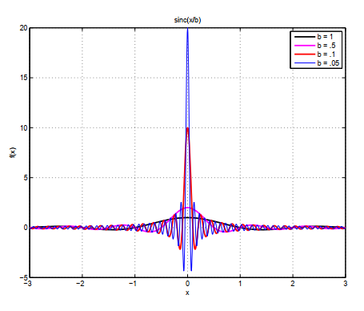
2. THE IMPULSE FUNCTIONS
冲激函数定义:
宽度无穷小，高度无穷大
积分等于一，只在零取值
MATLAB仿真
Notes:
1、We have considered several pulse functions, the rectangle, triangle, sinc, Gaussian, and even the sinc2 function (which we didn’t treat in the previous section). These functions are all plotted in Fig. 10. These functions all have diﬀerent widths, diﬀerent full-width half-maxes, diﬀerent numbers of zeros, etc. One important feature of all of these functions is that they have a total integrated area of |b|. Consider now the case in Fig. 11. In this ﬁgure we plot
2、Each of these functions has an integrated area of unity due to the normalization to b. However, as we decrease the scaling parameter, the peak increases and the width decreases in order to keep the overall area at 1.We can consider what happens as we allow the scaling parameter to go to 0. We can deﬁne the impulse function, also known as the Dirac delta function, as

Slide 14
2. THE IMPULSE FUNCTIONS
1、采样性质
Notes:
1、Now let’s look at some of the properties of the δ-function. First let’s consider its scaling properties. We can shift and scale the delta function just as we did earlier with other special functions. However, since the delta function is a genearlized function, the result is a bit diﬀerent.
2、This allows us to say that

Slide 15
2. THE IMPULSE FUNCTIONS
2、缩放性质
Notes:
1、Now let’s look at some of the properties of the δ-function. First let’s consider its scaling properties. We can shift and scale the delta function just as we did earlier with other special functions. However, since the delta function is a genearlized function, the result is a bit diﬀerent.
2、This allows us to say that

Slide 16
2. THE IMPULSE FUNCTIONS
3. 乘积性质
Notes:
The properties in this section all tell us that when we multiply the delta function by any other function, the result is a single delta function weighted by the value of the function it is multiplied by. This property will be found to be very important both in the future sections on sampling theory and on diffraction.

Slide 17
2. THE IMPULSE FUNCTIONS
4. 积分性质

Slide 18
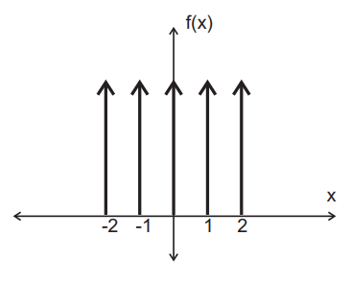
3. THE COMB FUNCTION
梳状函数:
缩放性质：
采样性质：
Notes:
1、In many applications we will ﬁnd it useful to have an array of delta functions that are evenly spaced. This function is often referred to as the comb function comb (() x). We deﬁne the comb function as
2、The conventional graphical representation of the comb function is shown in Fig. 13. If we want something other than integer spacing, we can use the scaling properties of the δ-function to write
3、These delta functions are separated by b, each with an integrated area of |b|. Later this semester we will see that the comb function is central to the development the sampling theory. This is because

Slide 19
4. DERIVATIVES AND INTEGRALS OF δ(X)
冲激函数的积分:
Notes:
1、We recognize this as the unit step function, so we can say that
2、Likewise we can consider the derivative of the δ-function. Let’s define

Slide 20
4. DERIVATIVES AND INTEGRALS OF δ(X)
冲激函数的微分性质:
Notes:
1、We can determine the properties of this function from the perspective of the integral
2、This function is often referred to as the doublet function. We can repeat this process as many times as we would like to, and the result is
3、where f (n) represents the nth derivative of f(x) (NOT f(x) raised to the nth power

Slide 21
谢谢！

