Slide 1
物理光学
Physical Optics
第3讲、谐波分析与傅立叶级数
Lecture 3. Harmonic Analysis and the Fourier Series

Slide 2
Lecture 3. Harmonic Analysis and the Fourier Series
基向量与向量空间：
y
二维空间中的任意矢量
可以按基向量进行分解
x
为什么要分解：
线性系统中便于计算
Notes:
We can abstract this concept to functions, and we can express a function of interest as a superposition of somebasis set as
where the ai are weights that give the relative contribution of each of the elements in the basis set. Note thatthe set {φi} are all function of the independent variable x, so the sum in Eq. 1 is also a function of x. An

Slide 3
Lecture 3. Harmonic Analysis and the Fourier Series
函数空间：基函数分解
例子：泰勒展开(基函数相同，系数不同，合成函数不同)
Notes:
We can abstract this concept to functions, and we can express a function of interest as a superposition of somebasis set as
where the ai are weights that give the relative contribution of each of the elements in the basis set. Note thatthe set {φi} are all function of the independent variable x, so the sum in Eq. 1 is also a function of x. An

Slide 4
Lecture 3. Harmonic Analysis and the Fourier Series
如何选择基函数？
先定义函数的内积
函数内积的定义：与矢量的内积类似
如果有： 定义在 之间连续可积
一种函数内积的定义：
Notes:
example of such an expansion is the Taylor series expansion, for example, when |x| < 1
In this class we are going to restrict ourselves to a particularly useful type of basis set that gives us an orthogonalexpansion. There are many examples of orthogonal expansions, but the general rules are the same. When we have a vector space or function space we can define an inner product on that space. The inner product is denoted as < f(x), g(x) >, and has the following properties.
Once we have an inner product we can define the concept of orthogonal functions

Slide 5
Lecture 3. Harmonic Analysis and the Fourier Series
一种函数内积的定义：
函数内积必须满足的性质
共轭性质：
线性性质：
正定性质：
Notes:
In this class we are going to restrict ourselves to a particularly useful type of basis set that gives us an orthogonal
expansion. There are many examples of orthogonal expansions, but the general rules are the same. When we
have a vector space or function space we can define an inner product on that space. The inner product is denoted as < f(x), g(x) >, and has the following properties.
1. Conjugate symmetry: f, g = g, f∗
2. Linearity: af, g = a f, g, f + h, g = f, g + h, g
3. Positivity: x, x > 0 for all x = 0
4. Definiteness: x, x = 0 implies x = 0.

Slide 6
Lecture 3. Harmonic Analysis and the Fourier Series
正交基函数的定义：与正交矢量类似
Kroneker函数
函数的正交分解：与矢量的正交分解类似
Notes:
example of such an expansion is the Taylor series expansion, for example, when |x| < 1
In this class we are going to restrict ourselves to a particularly useful type of basis set that gives us an orthogonalexpansion. There are many examples of orthogonal expansions, but the general rules are the same. When we have a vector space or function space we can define an inner product on that space. The inner product is denoted as < f(x), g(x) >, and has the following properties.
Once we have an inner product we can define the concept of orthogonal functions

Slide 7
Lecture 3. Harmonic Analysis and the Fourier Series
如何选取正交基函数？
如果有： 定义在 之间连续可积
选取一组特殊的基函数：
基函数的内积：
Notes:
We can define a frequency ξ0 = 1/T , and then we can write

Slide 8
Lecture 3. Harmonic Analysis and the Fourier Series

Slide 9
Lecture 3. Harmonic Analysis and the Fourier Series
如果
如果
综上
因此
是定义在 之间的函数 的一组正交基函数

Slide 10
Lecture 3. Harmonic Analysis and the Fourier Series
有了正交基函数，如何进行函数的正交分解：
关键在于如何求出正交基函数的系数：

Slide 11
Lecture 3. Harmonic Analysis and the Fourier Series
如果有： 定义在 之间连续可积
对其进行函数的正交分解有：
Notes:
Note that we have written the Fourier series in terms of the complex exponential functions, as this will afford us the most flexibility. For real-valued functions, we could have chosen instead to have written the Fourier series in terms of sines and cosines as

Slide 12
Lecture 3. Harmonic Analysis and the Fourier Series
大量实际物理量具有周期性
假设 具有周期性,周期为
正交分解有：
一个周期内的积分
Notes:
The coefficients cn provide the relative amounts of the various harmonics that contribute to the overallsignal. These coefficients can be computed using the formula
The value of x0 is arbitrary, and can be chosen to make the computation of the integral as convenient as possible.

Slide 13
Lecture 3. Harmonic Analysis and the Fourier Series
：代表傅立叶级数
：代表基频
：代表 谐波

Slide 14

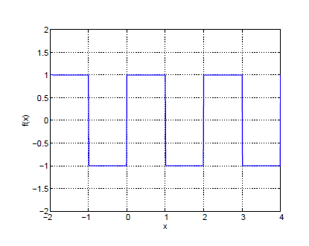
Lecture 3. Harmonic Analysis and the Fourier Series
方波：
MATLAB仿真
Notes:
Figure 2. Square wave signal

Slide 15
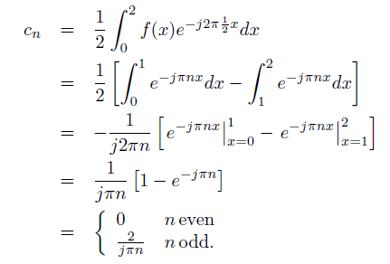
Lecture 3. Harmonic Analysis and the Fourier Series
Notes:
This expression tells us that the square wave is made up of only odd harmonics. We also see that the relative contribution of each successive odd harmonic diminishes like 1/n.

Slide 16
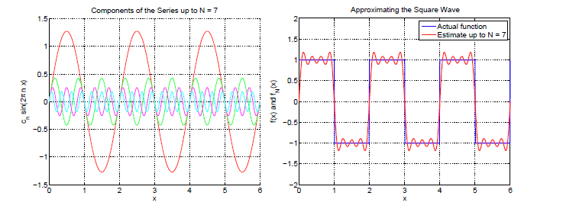
Lecture 3. Harmonic Analysis and the Fourier Series
方波函数的基函数分解：吉布斯效应
MATLAB仿真
Notes:
有n=7的仿真
3. TRUNCATED FOURIER SERIES

Slide 17
Lecture 3. Harmonic Analysis and the Fourier Series
傅立叶变换：函数的频谱
频谱:
(傅立叶变换)
连续函数
积分上下限
Notes:
4. THE FOURIER INTEGRAL
The Fourier series is defined for a continuous, periodic function. However, most functions in real physics are not truly periodic, and we might like to consider a similar analysis for non-periodic functions. We could make

Slide 18
Lecture 3. Harmonic Analysis and the Fourier Series
周期函数的傅立叶频谱
Notes:
We will spend some more time in the next lecture considering the Fourier transform and its properties. Right now, let’s look at some special cases of this Fourier integral. First, let’s see what happens when our signal f(x) = ej2πξ0x is a pure complex exponential. Of course, in this case the signal is periodic and we could write the Fourier series. But, let’s see what happens in the Fourier integral

Slide 19
Lecture 3. Harmonic Analysis and the Fourier Series
Notes:
Consider the integral in Eq. 21. It’s important to realize that this expression is a function of frequency ξ, and that ξ0 is a constant that represents the specific frequency of the specific complex exponential that we are investigating. When ξ = ξ0, we can replace ξ − ξ0 with frequency β, and we have the integral of a complex sinusoid over infinite limits. We know that if we integrate this function over an integer number of periods that it will be zero. The integral in Eq. 21 doesn’t have a specific answer (since we don’t define ∞), but because of
the periodic nature of the integrand, we say it is zero. Now consider what happens when ξ = ξ0. In this case the integrand is 1, and the integral evaluates to ∞! This means that

Slide 20
Lecture 3. Harmonic Analysis and the Fourier Series
Notes:
We will learn more about linearity later on this term, but we applied the principle of linearity to interchange
the order of the sum and the integral. Since each individual term in the sum has a Fourier integral that is a δ-function from Eq. 22, the Fourier integral of the entire periodic signal is itself a series of weighted δ-functions.

Slide 21
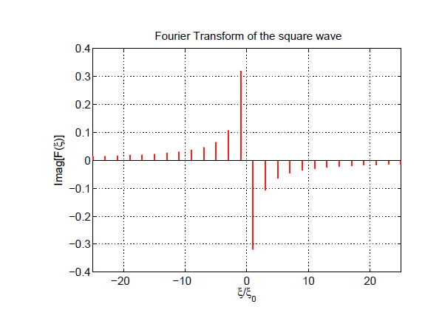
Lecture 3. Harmonic Analysis and the Fourier Series
傅立叶频谱与傅立叶级数的关系
连续
离散
MATLAB仿真
Notes:
Figure 5. Imaginary part of the Fourier transform of the square-wave function shown above. The real part of this Fourier transform is 0.

Slide 22
谢谢！

