Slide 1
物理光学
Physical Optics
第4讲、算子与线性位移不变系统
Lecture 4. Operators and Linear, Shift-Invariant Systems

Slide 2
Lecture 4. Operators and Linear, Shift-Invariant Systems
算子：
就是物理系统的数学模型
映射
算子（系统）的特性：线性、位移不变性
Notes:
One way of thinking of an operator is that it performs a mapping from a set of input functions {fi(x)} to a set of output functions {gi(x)}. The operator can be a differential equation, an integral transform, arithmetic operations, etc. One simple examply might be the 1-D Helmholtz equation which can be written

Slide 3
Lecture 4. Operators and Linear, Shift-Invariant Systems
线性系统：
输入输出满足线性叠加性质
有什么用？
把输入的复杂函数分解为基函数的叠加
Notes:
A linear system is a special system whose operator S obeys the following relationship. For an arbitrary pair of inputs f1(x) and f2(x) with corresponding outputs S{f1(x)} = g1(x) and S{f2(x)} = g2(x), we have

Slide 4
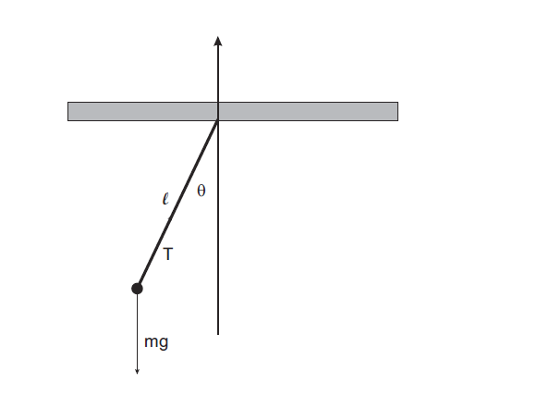
Lecture 4. Operators and Linear, Shift-Invariant Systems
非线性系统的线性化：刚性单摆的简谐运动
在一定近似条件下也可以看作线性系统
Notes:
Let’s look at a classic example of a nonlinear problem that can be linearized from mechanics. Figure 3 shows the free-body diagram for a simple pendulum. The equation of motion for this system is
Figure 3. Free body diagram for a pendulum.

Slide 5
Lecture 4. Operators and Linear, Shift-Invariant Systems
位移不变系统：
输入输出满足平移性质
有什么用？
对于仅有位移的输入函数不用重新计算输出
Notes:
For a shift-invariant systemfor all x and x0.
As an example, let’s consider a real optical imaging system that includes aberrations. If we consider an onaxispoint source, the image formed by the system will be some finite sized spot that is determined by sphericalaberration and diffraction. However, as we move off-axis, additional aberrations come into play, changing the point response of the system. This spatially-varying point spread function means that the image of the same object will depend upon where it is in the field. Hence, the system is not strictly shift-invariant.
However, for many optical systems the effects of aberrations are small enough that we can consider them as approximately shift-invariant over some range of field positions or numerical aperture. For example, if the effect of the aberrations are smaller than the size of the pixels in a CCD, then the system can usually be considered LSI. Strictly speaking, the point spread function and MTF of the system will be a function of field, and this is
a topic we’ll discuss in greater detail in a few lectures.

Slide 6
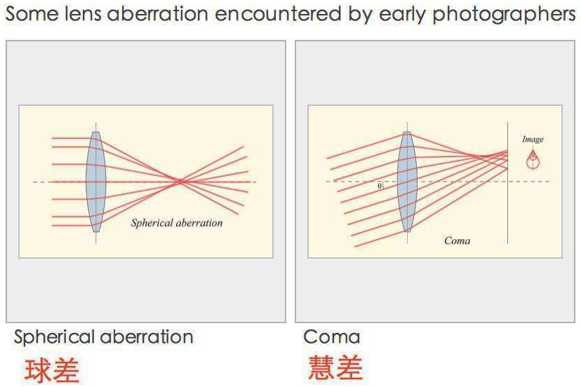
Lecture 4. Operators and Linear, Shift-Invariant Systems
非位移不变系统：成像像差
在一定近似条件下，也可以看作位移不变系统
Notes:
Let’s look at a classic example of a nonlinear problem that can be linearized from mechanics. Figure 3 shows the free-body diagram for a simple pendulum. The equation of motion for this system is
Figure 3. Free body diagram for a pendulum.

Slide 7
Lecture 4. Operators and Linear, Shift-Invariant Systems
线性位移不变系统的冲激响应函数
线性位移不变系统
冲激函数输入
冲激响应函数
Notes:
2.4. The impulse Response of a LSI System
In general we say that the LSI system is described by S{f(x)} = g(x). However, when the excitation of the system is an impulse function, we say that the output is the impulse response of the system, and we almost always denote this special response as h(x). Specifically, for LSI systems we have

Slide 8
Lecture 4. Operators and Linear, Shift-Invariant Systems
线性位移不变系统的空域分析方法
与冲激响应函数的卷积
Notes:
In Eq. 11 we have written the function f(x) as a summation of shifted δ-functions each weighted by the constant f(α). We are of course free to operate on f(x) in Eq. 11. Doing this and applying the principles of LSI systems yields

Slide 9
Lecture 4. Operators and Linear, Shift-Invariant Systems
线性位移不变系统的特征函数
定义类似矩阵的特征向量
线性位移不变系统
特征函数
加权输出
特征函数输入
特征函数
特征值
Notes:
An eigenfunction of a system satisfies the special property that the output of the system is the same function as the input, but scaled by a possibly complex constant. Consider a family of functions ψ(x; ξ) that are function of x but parameterized by ξ. An example of such a family would be the sinusoids cos(2πξx). If this family is a set of eigenfunction of a system they have the mathematical property

Slide 10
Lecture 4. Operators and Linear, Shift-Invariant Systems
一种特殊的特征函数
根据线性性质有：
根据位移不变性质有：
Notes:
Let’s say that we have been given a system described by the operator L{}. The only thing that we know about L{} is that it is a LSI operator. Now let’s see what happens if the input to our system is a complex exponential of frequency ξ. We have
Since our system is linear, we know that we can multiply the input by the complex constant e−j2πξx0 and write
However, because our system is shift invariant, we could have chosen to write Eq. 18 as

Slide 11
Lecture 4. Operators and Linear, Shift-Invariant Systems
求解方程
得：
（一个特解）
（一组通解）
复数加权因子
复指数函数
是任意线性位移不变系统 的特征函数
Notes:
Equating Eq. 18 and Eq. 19 allows us to write
Equation 20 tells us that

Slide 12
Lecture 4. Operators and Linear, Shift-Invariant Systems
线性位移不变系统的频域分析方法
Notes:
2.6. The Transfer Function
Let’s now turn our attention to the eigenvalue H(ξ). We will soon find out that we can take an arbitrary function f(x) and write it as a superposition of sine wave through the inverse Fourier transform

Slide 13
Lecture 4. Operators and Linear, Shift-Invariant Systems
线性位移不变系统的空域分析方法
冲激响应函数
系统传递函数
线性位移不变系统的频域分析方法
Notes:
Figure 7. Dual-domain description of LSI systems

Slide 14
谢谢！

