Slide 1
物理光学
Physical Optics
第8讲、二维函数、卷积、与傅里叶变换
Lecture 8. Two Dimensional Functions, Convolution, and
Fourier Transforms

Slide 2
8. Two Dimensional Functions, Convolution, and Fourier Transforms
二维函数的表示方法
笛卡尔坐标系
柱坐标系
二维可分离函数：二维函数分解为一维函数相乘

Slide 3
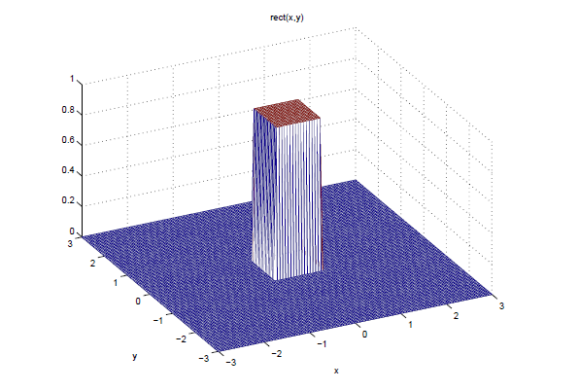
8. Two Dimensional Functions, Convolution, and Fourier Transforms
直角坐标系中的常见二维函数
二维门函数
Figure 1. Plot of the two-dimensional rect function.

Slide 4
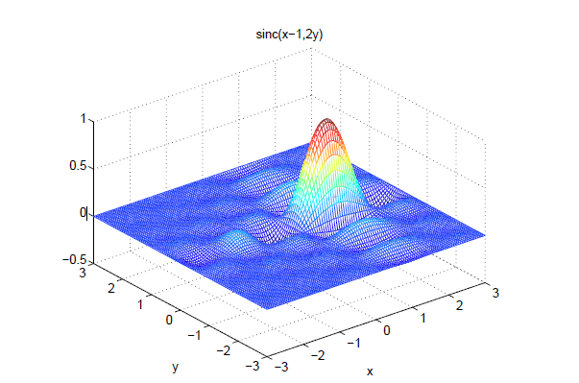
8. Two Dimensional Functions, Convolution, and Fourier Transforms
二维sinc函数
Figure 2. Two-dimensional sinc function at x0 = 1, b = 1, y0 = 0, and d = 0.5.

Slide 5
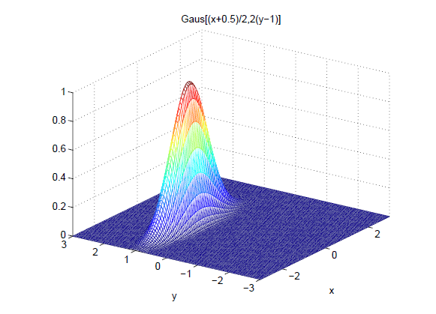
8. Two Dimensional Functions, Convolution, and Fourier Transforms
二维高斯函数
Figure 3. Two-dimensional Gaussian function with x0 = -0.5, b = 2, y0 = 1, and d = 0.5.

Slide 6
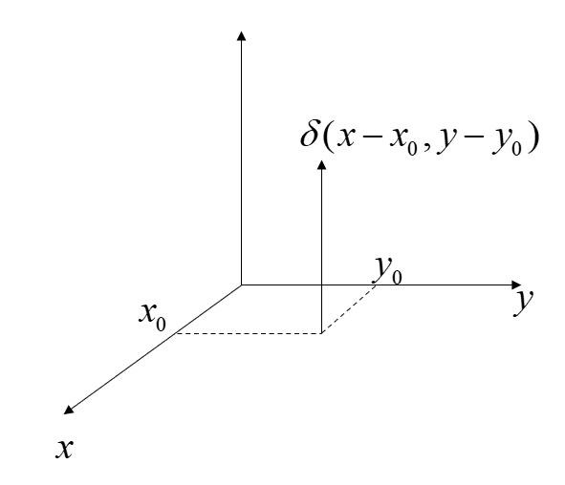
8. Two Dimensional Functions, Convolution, and Fourier Transforms
二维梳状函数

Slide 7
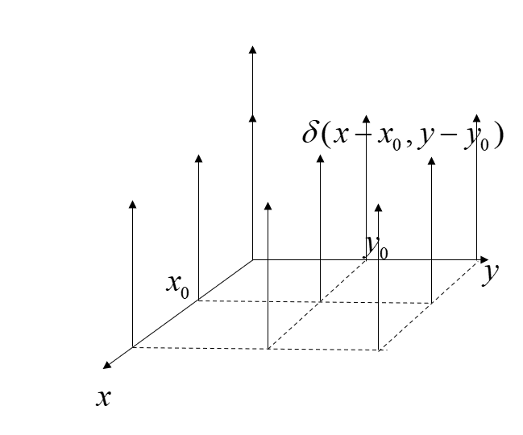
8. Two Dimensional Functions, Convolution, and Fourier Transforms
二维梳状函数

Slide 8
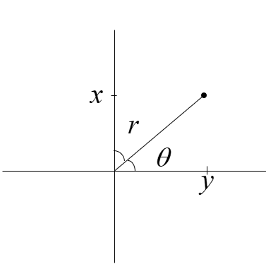
8. Two Dimensional Functions, Convolution, and Fourier Transforms
直角坐标系与柱坐标系的转化
为什么要用柱坐标系？轴对称光学系统

Slide 9
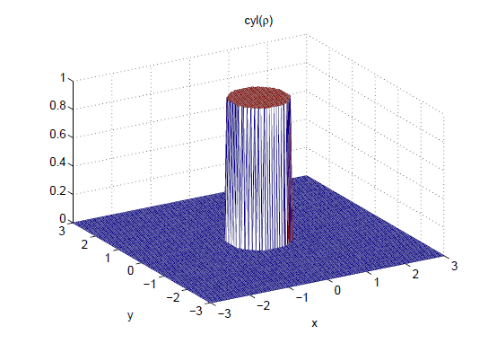
8. Two Dimensional Functions, Convolution, and Fourier Transforms
柱坐标系中的常见二维函数
二维圆柱函数
Figure 4. The cylinder function according to the definition of Gaskill.

Slide 10
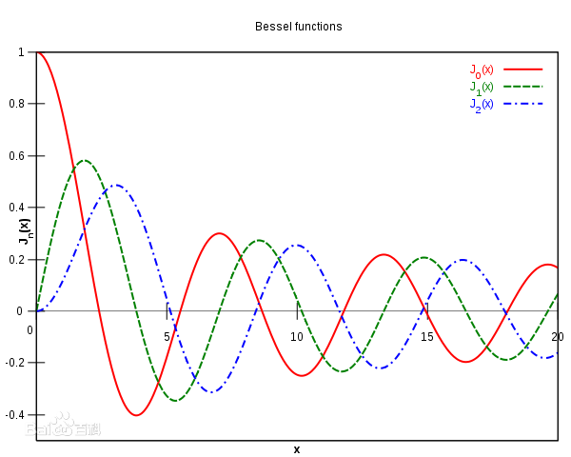
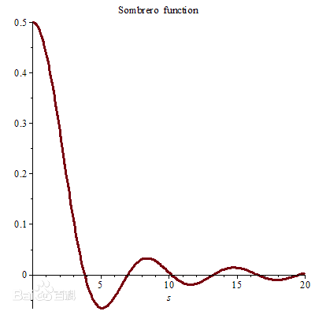
8. Two Dimensional Functions, Convolution, and Fourier Transforms
柱坐标系中的常见二维函数
二维礼帽函数墨西哥草帽：圆形孔径的相干点扩散函数
：第一类一阶贝塞尔函数
二维礼帽函数一维剖线图
第一类0-2阶贝塞尔函数曲线

Slide 11
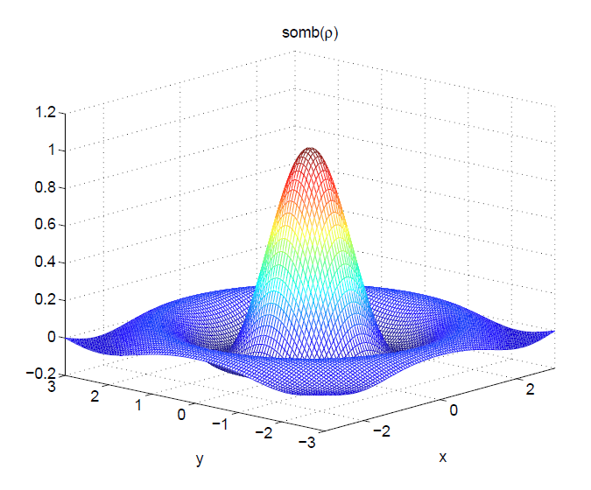
8. Two Dimensional Functions, Convolution, and Fourier Transforms
柱坐标系中的常见二维函数
二维礼帽函数墨西哥草帽：圆形孔径的相干点扩散函数
：第一类一阶贝塞尔函数
Figure 5. The Sombrero function as defined by Gaskill.

Slide 12
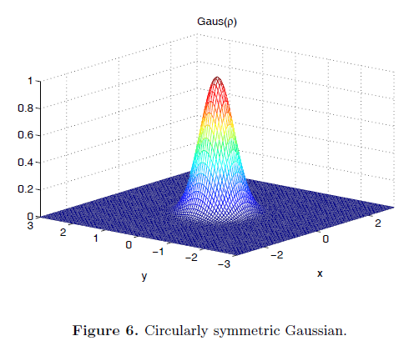
8. Two Dimensional Functions, Convolution, and Fourier Transforms
柱坐标系中的常见二维函数
二维高斯函数

Slide 13
8. Two Dimensional Functions, Convolution, and Fourier Transforms
二维函数的卷积
若为二维可分离函数：

Slide 14
8. Two Dimensional Functions, Convolution, and Fourier Transforms
二维傅里叶变换
若为二维可分离函数：

Slide 15
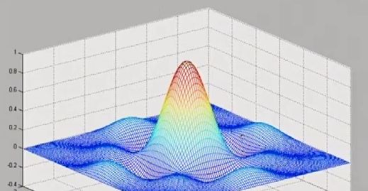
8. Two Dimensional Functions, Convolution, and Fourier Transforms
三组重要的二维傅里叶变换对

Slide 16
8. Two Dimensional Functions, Convolution, and Fourier Transforms
三组重要的二维傅里叶变换对

Slide 17
8. Two Dimensional Functions, Convolution, and Fourier Transforms
三组重要的二维傅里叶变换对

Slide 18
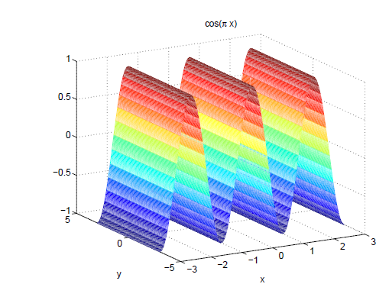
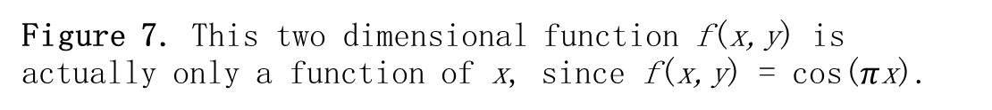
8. Two Dimensional Functions, Convolution, and Fourier Transforms
一元二维函数的傅里叶变换
Figure 7. This two dimensional function f(x,y) is actually only a function of x, since f(x,y) = cos($π$x).

Slide 19
8. Two Dimensional Functions, Convolution, and Fourier Transforms
二维傅里叶变换的卷积定理

Slide 20
谢谢！

